Slide 1
Design Ambassadors
Design Thinking Fundamentals - B2C Edition

Slide 2
Comprensión
Design Ambassadors: Design Thinking Fundamentals
‹#›
DÍA 1
BBVA Design Thinking Fundamentals

Slide 3
Materiales necesarios

Slide 4
Tu cartera dice mucho de tí…
¿Lo sabías?
Notes:
1/3 WALLET EXERCISE / Give Instructions (5’)
“Now you’re going to take out your wallets and get into pairs. We’re going to kick off with a quick exercise… ”

Slide 5
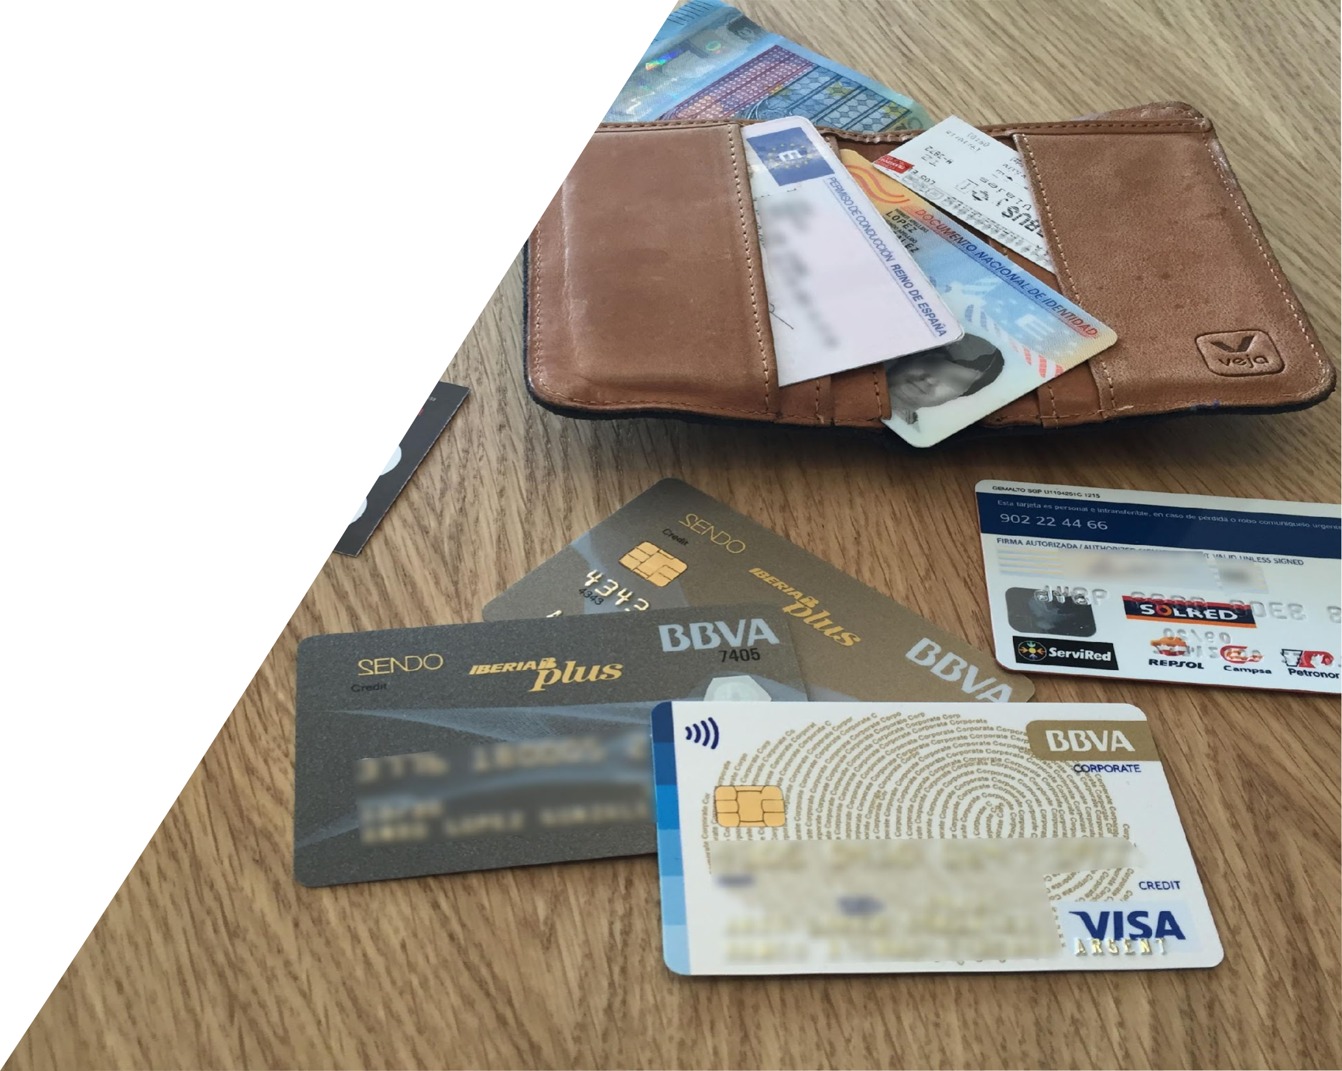
Tu cartera habla mucho de tí… ¿Lo sabías?
25’
Por parejas
Intercambiad vuestras carteras.
En silencio
Explora la cartera de tu compañero y anota lo que aprendas de esa persona.
Entrevista
Entrevista a tu compañero/a y viceversa.
Puesta en común
¿Qué hemos descubierto?
5’
5’
Notes:
2/3 WALLET EXERCISE / Give Instructions (5’)
“Get into pairs and swap wallets.”
“You can use the notes pages in the manual to note down the lessons learned in the exercise.”
[In the sharing exercise I invite you to note down the lessons you’ve learned in your manual (pages at the end), so you can see that you may have had preconceived ideas, prejudices, and above all that you can learn a lot by observing and listening to someone.]

Slide 6
¡Enhorabuena!
Ya has empezado a pensar como un Design Thinker…
Notes:
3/3 WALLET EXERCISE / ALL: Share Learning Experience (10’)
“Get into pairs and swap wallets.”
“You can use the notes pages in the manual to note down the lessons learned in the exercise.”
[In the sharing exercise I invite you to note down the lessons you’ve learned in your manual (pages at the end), so you can see that you may have had preconceived ideas, prejudices, and above all that you can learn a lot by observing and listening to someone.]

Slide 7
¡Bienvenido!
Notes:
1/3 WELCOME / Introducing the team (1’)

Slide 8
¡Bienvenido!
Conoce al equipo
Notes:
2/3 WELCOME / BBVA Team (1’)

Slide 9
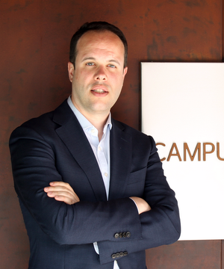
EQUIPO PROYECTO
Formadores

Slide 10
EQUIPO PROYECTO
Facilitadores
Nicolas LeBlanc
Strategy Designer
Sagrado Nova
Design Transformation
Enrique Gil Sacristán
Design Transformation
Notes:
3/3 WELCOME / BBVA Team (1’)
Let’s start by introducing the team that is working on this workshop.

Slide 11
¿Por qué estamos aquí?
Notes:
11 SLIDE WHY ARE WE HERE? (10’)

Slide 12
Hemos hecho grandes progresos en nuestras metas de Transformación…
Hemos desarrollado nuevas capacidades como Agile, Data, Design.
Nuevas maneras de trabajar cómo SDA, Triangle, Agile organization.
La organización evoluciona en lo relativo a personas, cultura e incentivos.
Notes:
1/11 WHY ARE WE HERE? / Overview (10’)

Slide 13
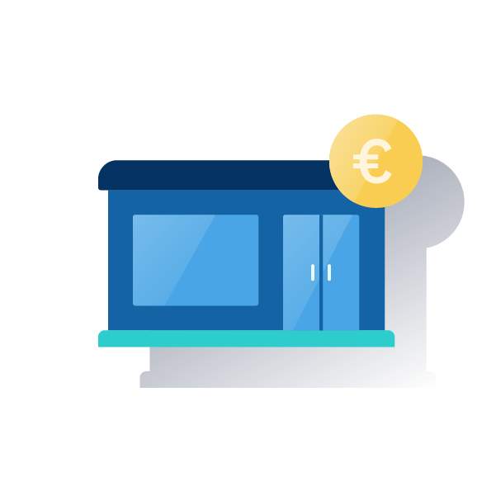
… pero tenemos grandes retos por delante.
La disrupción tecnológica conlleva una revolución en las expectativas del cliente.
Nos enfrentamos a nuevos actores como fintechs o techfins.
El rol de los bancos está cambiando en un marco social global.
Los modelos tradicionales se están mostrando menos efectivos.
Notes:
2/11 WHY ARE WE HERE? / Overview (10’)

Slide 14
Las empresas orientadas al diseño consiguen unos beneficios
en el S&P 500 un
219%
por encima del resto.
Notes:
3/11 WHY ARE WE HERE? / Overview (10’)

Slide 15
El Design Thinking nos ayuda a crear productos y servicios innovadores basados en las necesidades de los clientes.
Reduce costes
Reduce el riesgo
Mejora la eficiencia
Mejora el compromiso de los empleados
Notes:
4/11 WHY ARE WE HERE? / Overview (10’)

Slide 16
Los productos, los negocios y los mercados tienen un ciclo de vida
VENTAS
TIEMPO
Inversión
Beneficio
Declive
Notes:
5/11 WHY ARE WE HERE? / Overview (10’)

Slide 17
La innovación continua rompe estos ciclos
VENTAS
TIEMPO
Inversión
Beneficio
Declive
Notes:
6/11 WHY ARE WE HERE? / Overview (10’)

Slide 18
La innovación continua rompe estos ciclos
VENTAS
TIEMPO
Inversión
Beneficio
Declive
Notes:
7/11 WHY ARE WE HERE? / Overview (10’)

Slide 19
Podemos dirigir la innovación mediante el Design Thinking
Beneficio
Quién
Qué
Por qué
Design
Thinking
Inversión
Notes:
8/11 WHY ARE WE HERE? / Overview (10’)

Slide 20
Podemos dirigir la innovación mediante el Design Thinking
Beneficio
Agile
Cómo
Design
Thinking
Inversión
Notes:
9/11 WHY ARE WE HERE? / Overview (10’)

Slide 21
Las soluciones que aporta el Design Thinking abarcan un amplio espectro de necesidades, usuarios y circunstancias
Notes:
10/11 WHY ARE WE HERE? / Overview (10’)

Slide 22
Las empresas más competitivas de hoy en día no solo utilizan el Design Thinking, sino que innovan a través de esta manera de pensar.
Notes:
11/11 WHY ARE WE HERE? / Overview (10’)

Slide 23
¿Qué es el Design Thinking?
Notes:
21 SLIDES INTRO TO DESIGN THINKING (30’)

Slide 24
Diseño es una palabra un tanto engañosa. Hay quien piensa que diseño significa aspecto. Pero, naturalmente, si se escarba un poco, se refiere realmente a cómo funciona.
- Steve Jobs
Notes:
1/21 INTRODUCTION TO DESIGN THINKING / Defining Design Thinking (10’)

Slide 25
¿Qué se diseña?
Notes:
2/21 INTRODUCTION TO DESIGN THINKING / ASK: What’s designed (5’)

Slide 26
Piensa en un producto o un servicio que te guste mucho.
Notes:
3/21 INTRO TO DESIGN THINKING / ASK: Think of a product/service. Why do you like it? Why does it work well? (5’)
“Design Thinking… If we’re thinking of design, let’s talk about design. What’s design in your opinion?
[They don’t need to tell what is their favorite product or service, just to think about one]

Slide 27
¿Por qué te gusta?
¿Por qué funciona tan bien?
Notes:
4/21 INTRO TO DESIGN THINKING / ASK: Think of a product/service. Why do you like it? Why does it work well? (5’)
“Design Thinking… If we’re thinking of design, let’s talk about design. What’s design in your opinion?
[I write down all the reasons why they love the products and services they are thinking about. I try to write it down from a personal standpoint like “Because I find it easy to use”, “Because I find it pretty”, “Because it gives me amusement”,…]

Slide 28
Útil
Inteligente
Fácil de usar
Intuitivo
Notes:
5/21 INTRO TO DESIGN THINKING / ASK: Think of a product/service. Why do you like it? Why does it work well? (5’)
“Design Thinking… If we’re thinking of design, let’s talk about design. What’s design in your opinion?
[I read some extra points that might coincide with what they’ve already said, strengthening the fact that it’s always from our point of view and that’s why we love it]

Slide 29
Porqué está centrado en el usuario
Notes:
6/21 INTRO TO DESIGN THINKING / ASK: Think of a product/service. Why do you like it? Why does it work well? (5’)
“Design Thinking… If we’re thinking of design, let’s talk about design. What’s design in your opinion?

Slide 30
Centrado en las personas
Notes:
7/21 INTRO TO DESIGN THINKING / DESIGN THINKING SUPERPOWERS (5’)
“These are the 3 superpowers of Design Thinking…”
We start with human needs, understanding our customer and inviting him to co-create with us in different moments of the process.

Slide 31
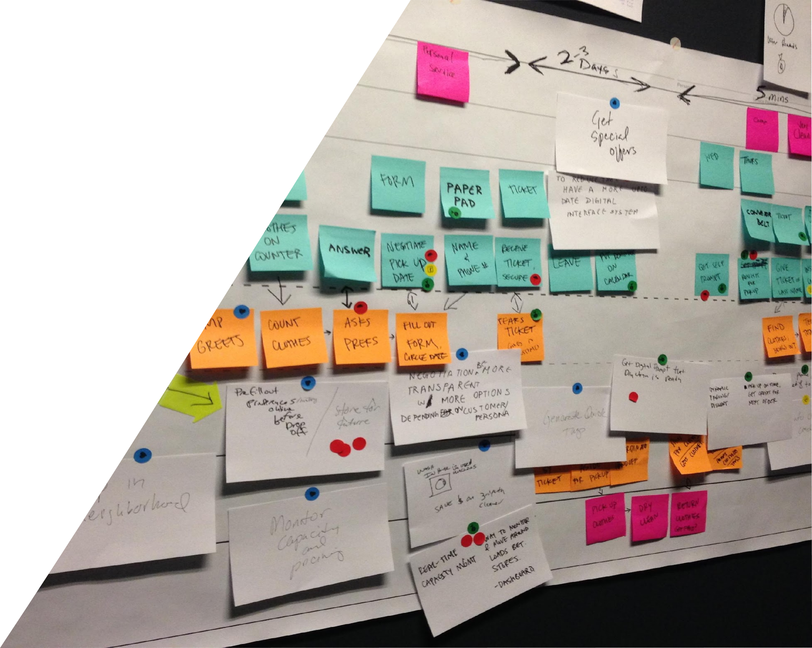
Visual y colaborativo
Notes:
8/21 INTRO TO DESIGN THINKING / DESIGN THINKING SUPERPOWERS (5’)
“These are the 3 superpowers of Design Thinking…”
We start with human needs, understanding our customer and inviting him to co-create with us in different moments of the process.

Slide 32
Validado e iterativo
Notes:
9/21 INTRO TO DESIGN THINKING / DESIGN THINKING SUPERPOWERS (5’)
“These are the 3 superpowers of Design Thinking…”
We start with human needs, understanding our customer and inviting him to co-create with us in different moments of the process.

Slide 33
El Design Thinking es un marco de trabajo para la resolución de problemas y para la creación de soluciones a clientes.
Se basa en la investigación con usuarios, el aprendizaje a través de la experimentación con prototipos y en herramientas de trabajo colaborativo que potencian la creatividad.
El pensamiento de diseño se enfoca estratégicamente en el descubrimiento, la acción y la mejora constante.
Notes:
10/21 INTRODUCTION TO DESIGN THINKING / ASK: What’s designed (5’)
IT IS A MINDSET.
This process emphasizes balancing creative and analytical skills ( < | > ) and calls for shifting between generating ideas, prototyping and quickly testing them to arrive at a final solution.

Slide 34
Las 3 lentes del Design Thinking
Viabilidad
Deseabilidad
Factibilidad
Notes:
11/21 INTRODUCTION TO DESIGN THINKING / Design Thinking Process (10’)

Slide 35
El triángulo de BBVA
Negocio
Experiencia
Tecnología
Notes:
12/21 INTRODUCTION TO DESIGN THINKING / Design Thinking Process (10’)

Slide 36
Una forma distinta de trabajar
JERÁRQUICA
Éxito fortuito
Se consideran menos ideas
Conceptos no explorados
COMPETITIVA
Más probabilidades de éxito
Ganan las mejores ideas
Se desarrollan los conceptos más sólidos
Notes:
13/21 INTRODUCTION TO DESIGN THINKING / Design Thinking Process (10’)

Slide 37
El proceso de Design Thinking
Evaluar
Comprender
con clientes reales para asegurarnos de que nuestra solución cubre sus necesidades.
las necesidades y comportamientos reales para descubrir nuevas oportunidades e identificar el problema a resolver.
Prototipar
Idear
modelos comprobables para iterar rápidamente y mejorar nuestras soluciones.
tantas ideas de solución como sea posible para elegir la mejor y construirla.
Notes:
14/21 INTRODUCTION TO DESIGN THINKING / Design Thinking Process (10’)

Slide 38
El proceso de Design Thinking
Evaluar
Comprender
con clientes reales para asegurarnos de que nuestra solución cubre sus necesidades.
las necesidades y comportamientos reales para descubrir nuevas oportunidades e identificar el problema a resolver.
Prototipar
Idear
modelos comprobables para iterar rápidamente y mejorar nuestras soluciones.
tantas ideas de solución como sea posible para elegir la mejor y construirla.
Notes:
14/21 INTRODUCTION TO DESIGN THINKING / Design Thinking Process (10’)

Slide 39
El proceso de Design Thinking
Evaluar
Comprender
con clientes reales para asegurarnos de que nuestra solución cubre sus necesidades.
las necesidades y comportamientos reales para descubrir nuevas oportunidades e identificar el problema a resolver.
Prototipar
Idear
modelos comprobables para iterar rápidamente y mejorar nuestras soluciones.
tantas ideas de solución como sea posible para elegir la mejor y construirla.
Notes:
14/21 INTRODUCTION TO DESIGN THINKING / Design Thinking Process (10’)

Slide 40
El proceso de Design Thinking
Evaluar
Comprender
con clientes reales para asegurarnos de que nuestra solución cubre sus necesidades.
las necesidades y comportamientos reales para descubrir nuevas oportunidades e identificar el problema a resolver.
Prototipar
Idear
modelos comprobables para iterar rápidamente y mejorar nuestras soluciones.
tantas ideas de solución como sea posible para elegir la mejor y construirla.
Notes:
14/21 INTRODUCTION TO DESIGN THINKING / Design Thinking Process (10’)

Slide 41
El proceso de Design Thinking
Evaluar
Comprender
con clientes reales para asegurarnos de que nuestra solución cubre sus necesidades.
las necesidades y comportamientos reales para descubrir nuevas oportunidades e identificar el problema a resolver.
Prototipar
Idear
modelos comprobables para iterar rápidamente y mejorar nuestras soluciones.
tantas ideas de solución como sea posible para elegir la mejor y construirla.
Notes:
14/21 INTRODUCTION TO DESIGN THINKING / Design Thinking Process (10’)

Slide 42
La innovación no es una moda.
El Design Thinking es un camino
hacia la innovación…
Notes:
19/21 INTRODUCTION TO DESIGN THINKING / Defining Design Thinking (10’)
“Innovating is not in fashion because we’ve always innovated and it’s a way of evolving…”
“BBVA has been using Design Thinking since 2011, and today many public and private organizations and startups work with this vision and this methodology. The aim today is to use the potential of Design Thinking more and more in the different areas of our work.”

Slide 43
CASE STUDY:
Intuit
Notes:
20/21 INTRODUCTION TO DESIGN THINKING / Defining Design Thinking (10’)

Slide 44
Design
for Delight
“Un caso de éxito de transformación a través del Design Thinking”.
Net Promoter Score pasó de
un 45% a un 80%.
Notes:
21/21 INTRODUCTION TO DESIGN THINKING / Defining Design Thinking (10’)
Before
American software company to help people and small businesses manage their taxes
Became overly reliant on opaque algorithm and internal processes
NPS = 45%, among the lowest in it’s industry
After
Implemented Design For Delight
User-centered, fast prototyping, co-creation
Implemented via changing processes, resource allocation, incentive system
NPS jumped to 80%

Slide 45
ACTIVIDAD:
Tarjetas pirámide
Notes:
1 SLIDE ACTIVITY: PYRAMID CARDS (30’)
“Design Thinking is about knowing the people you are giving solutions to. So let’s start knowing each other.”

Slide 46
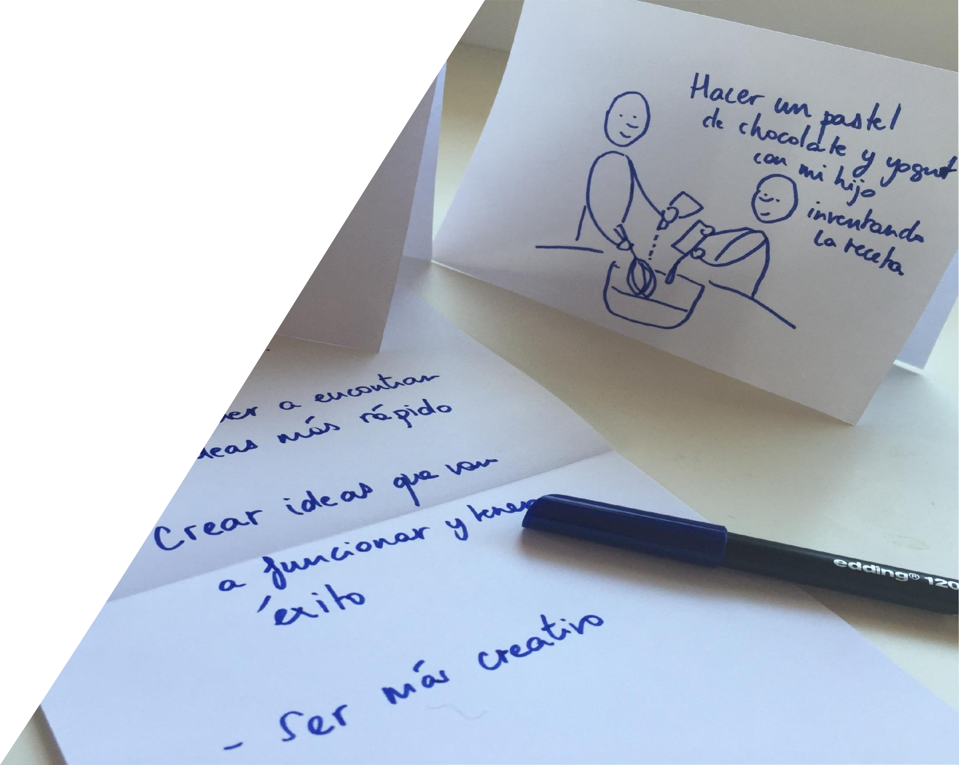
Tarjetas pirámide de presentación y expectativas
Notes:
1/1 ACTIVITY: PYRAMID CARDS / INDIVIDUALLY - Pyramid Activity (30’)
2’ to explain the exercise: Fold a piece of A5 card and do the following:
Side 1: Write Your name
Side 2: A drawing of something creative you’ve done recently, professionally or personally
Inside the fold: Write 3 expectations you have from this workshop
3’ for the activity
25’ for sharing: less than 1’ per person. Everyone shares their name, shows their drawing and reads their expectations.

Slide 47
El taller
Notes:
41 SLIDE WORKSHOP OVERVIEW (??’)
The reason“design-infused” companies are so successful is because they are innovative.
They are not only able to respond to rapid change, they are able to get out front and shape that change. One way they do that is by empowering their entire workforce to make smart, creative and customer centric decisions.
Here’s a quick video to show you how the Ambassador Program is doing this at BBVA.

Slide 48
El taller
Objetivos del Taller
Notes:
9 SLIDES WORKSHOP OBJECTIVES (5’)

Slide 49
Objetivos
Explorar el proceso de Design Thinking mediante un caso real
Aprender y poner en práctica esta manera de pensar y su metodología
Aprender herramientas y técnicas que puedas compartir con tu equipo
Identificar como puede ayudar en tu trabajo diario
…es más hacer que pensar
Notes:
1/9 WORKSHOP OVERVIEW / Workshop Objectives (5’)
Let’s start by introducing the team that is working on this workshop
“The goals of this course are as follows...”
[I read each of the goals slowly. You can complete the explanation for some points very briefly and then look at everything in more detail later.]
“As you’ll see it’s more ’doing’ than ‘thinking’”. The idea is above all for you to practice.”

Slide 50
Reglas del juego
MANOS ARRIBA
UNA CONVERSACIÓN A LA VEZ
TELÉFONOS EN SILENCIO
CERO EGO
CONFÍA EN EL PROCESO
Notes:
2/9 WORKSHOP OVERVIEW / Rules of Play (2’)
Hands Up: When you see a raised hand, imitate, and remain quiet until everyone is quiet. It’s the most time efficient (and sound efficient!) way to get everyone’s attention
1 at a time: this will be strictly enforced in order to ensure that every idea is heard, and that the creative process remains orderly, productive and positive
Phones in silent mode: You’re time is expensive, and so consider this week as a very intensive investment on both your part and the bank’s. If it’s really urgent, step outside to take the call
No “I’m sorry”: there are no reasons to say I’m sorry, mistakes are needed in order to learn and get to an interesting outcome.
Zero ego: you will make mistakes, you will fail, but you will and your team will learn from them, and get tp a better outcome as a result
Trust the process: it will seem messy, chaotic, and confusing at times. That’s ok. Trust the process, and you’ll get to the full value at the end of it!

Slide 51
Te invitamos a aprender haciendo con un proyecto práctico de 4 días
Notes:
3/9 INTRODUCTION TO DESIGN THINKING / Design Thinking Process (10’)

Slide 52
¿Cómo podríamos acompañar a nuestros usuarios a lo largo de toda su vida financiera?
Notes:
4/9 INTRODUCTION TO DESIGN THINKING / Design Thinking Process (10’)

Slide 53
Actividad
2’
Escribe tu reto en un papel A4 para que sea visible por todo el equipo
¿Cómo podríamos acompañar a nuestros usuarios a lo largo de toda su vida financiera?
Notes:
5/9 INTRODUCTION TO DESIGN THINKING / Design Thinking Process (10’)

Slide 54
Vamos a…
Trabajar desde el punto de vista del cliente
Desarrollar nuevas habilidad para trabajar y crear soluciones de un modo colaborativo
Prototipar e iterar ideas de un modo simple y eficiente. Tomar riesgos y perseguir ideas que nos emocionen
Aprender como dar y recibir un feedback constructivo y honesto
Equivocarnos y aprender de los errores. Movernos rápido y aprender a usar el tiempo como un acelerador creativo
Notes:
6/9 WORKSHOP OVERVIEW / Workshop Objectives (5’)
We’re going to:
Work from the customer’s point of view, listening to them directly
Create solutions in a collaborative and enriching way, giving us honest feedback, developing skills to favor this
Prototype ideas in a simple and economical way to be able to make design decisions and iterate the solution.
We’re going to go quite fast so we can experiment, and then we’ll reflect at the end of each day.
We’re going to work as a team. This is essential to be a good ‘design thinker’ and ‘doer’.
It’s going to be practical. We want you to experience everything for yourselves.
We’re aiming to DO, to make mistakes, we’re not looking for perfection.
We may find ourselves outside our comfort zone – but that’s what this process is about.
We’re going to try and have fun so we learn better.
We’re going to approach the steps in a constructive and honest way.
We’re going to take risks, follow up on more daring ideas, to make the most of this free and open space.

Slide 55
¡Una auténtica
montaña rusa!
Notes:
7/9 WELCOME / Welcome Slides (2’)
About this workshop:
it will feel like a rollercoaster ride
it will be uncomfortable for some
you’ll be flexing some new muscles (creativity, divergence, visual thinking, etc)

Slide 56
Además, vamos a…
Notes:
8/9 WORKSHOP OVERVIEW / Workshop Objectives (5’)

Slide 57
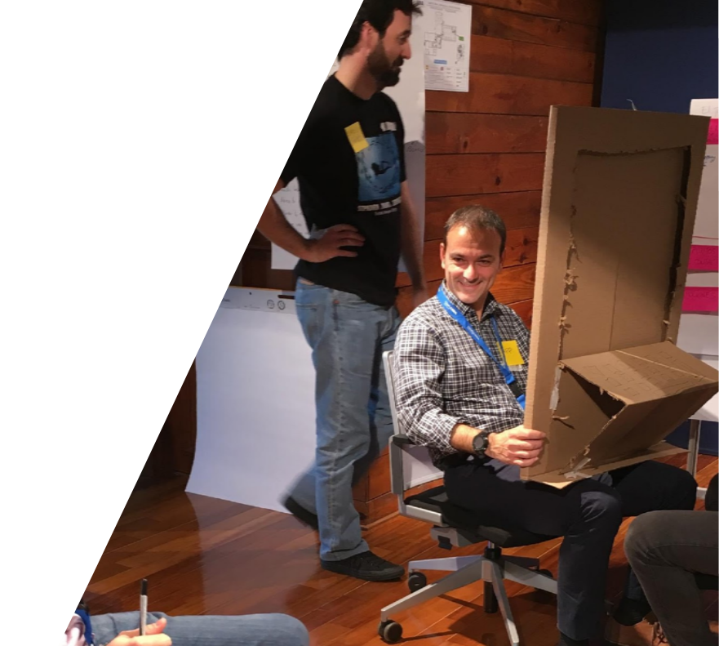
¡Pasarlo bien!
Notes:
9/9 WORKSHOP OVERVIEW / Workshop Objectives (5’)
Make the business case for fun in the presenter notes. Fun is good business…

Slide 58
Nuestro plan para esta semana
Notes:
3 SLIDES WORKSHOP SCHEDULE (5’)

Slide 59
El proceso de Design Thinking
Evaluar
Comprender
con clientes reales para asegurarnos de que nuestra solución cubre sus necesidades.
las necesidades y comportamientos reales para descubrir nuevas oportunidades e identificar el problema a resolver.
Prototipar
Idear
modelos comprobables para iterar rápidamente y mejorar nuestras soluciones.
tantas ideas de solución como sea posible para elegir la mejor y construirla.
Notes:
1/3 WORKSHOP OVERVIEW / Schedule (5’)
“Actually we’re going to follow the Design Thinking process,
which consists of first Understanding the user, the organization, the different actors and the context,
then Ideating, and Prototyping, Assessing and Iterating to improve the solution.
This is an iterative process, which is why we show it as a circle.”

Slide 60
Nuestro plan sigue el proceso
Comprensión
Ideación
Prototipado
Evaluación
DÍA 1
DÍA 2
DÍA 3
DÍA 4
Reglas de oro
Introducción al DT
Comprender al usuario
Compartir la pre-tarea
Organizar y categorizar
Mapa de ecosistema
Persona
Journey Map
Visual Thinking
Creatividad en equipo
Insights y oportunidades
Reformular el reto
Generación de ideas
Principios de diseño
Mapa de concepto
Propuesta de valor
Modelo de negocio
Introducción al prototipado
Prototipar el Journey ideal
Customer Engagement Loop
Charla de embajador
Bodystorming
Introducción a la evaluación
Evaluación con prototipos en papel y prototipos interactivos
Test de usuario
Iteración de los resultados
Presentación final
Organizar y documentar
Proyecto y equipo
Notes:
2/3 WORKSHOP OVERVIEW / Schedule (5’)
“That means we’re going to do”
[I read each of the points slowly. You can complete the explanation for some points very briefly and then look at everything in more detail later.]

Slide 61
Nuestro plan sigue el proceso
DÍA 1
Reglas de oro para crear en equipo
Introducción al Design Thinking
Compartir pre-tarea
Organizar y categorizar los datos
Comida (75 minutes)
Crear un mapa de ecosistema
Persona
Journey Map
Compartir aprendizajes
Notes:
3/3 WORKSHOP OVERVIEW / Schedule (5’)
[I describe the steps of the day, I explain there will also be a break at around 11 o’clock and lunch at 1:30.]

Slide 62
Herramienta
El manual de Design Thinking
Notes:
6 SLIDES THE DESIGN THINKING MANUAL (5’)

Slide 63
Manual de
Design Thinking
Escribe tu nombre e información de contacto en la página 3 del manual
Notes:
1/6 WORKSHOP OVERVIEW / Present the DTF Manual + Roadmap (2’)
INDIVIDUALLY: Write your name and contact info on page 3 of the manual

Slide 64
Manual de
Design Thinking
¿Cómo se organiza el manual?
Notes:
2/6 WORKSHOP OVERVIEW / Present the DTF Manual + Roadmap (2’)

Slide 65
Manual de Design Thinking
¿CÓMO SE ORGANIZA EL MANUAL?
Herramienta de gran valor en esta fase
Notes:
3/6 WORKSHOP OVERVIEW / Present the DTF Manual + Roadmap (2’)
List of Tools + Skills (p.5-6):
Color coded per the relevant phase
Filled in means it’s a highly valuable tool for the phase

Slide 66
Manual de Design Thinking
¿CÓMO SE ORGANIZA EL MANUAL?
Herramienta complementaria en esta fase
Notes:
4/6 WORKSHOP OVERVIEW / Present the DTF Manual + Roadmap (2’)
List of Tools + Skills (p.5-6):
Color coded per the relevant phase
Filled in means it’s a highly valuable tool for the phase

Slide 67
Manual de Design Thinking
¿CÓMO SE ORGANIZA EL MANUAL?
Herramienta clave del Design Thinking
Notes:
5/6 WORKSHOP OVERVIEW / Present the DTF Manual + Roadmap (2’)
List of Tools + Skills (p.5-6):
Color coded per the relevant phase
Filled in means it’s a highly valuable tool for the phase

Slide 68
La hoja de ruta
Notes:
6/6 WORKSHOP OVERVIEW / Present the DTF Manual + Roadmap (2’)
“We’re going to use this roadmap to check the tools we see each day and the skills we use and develop…”
[I check that everyone has one.]

Slide 69
Reglas de Oro para la creación en equipo
Notes:
16 SLIDES GOLDEN RULES FOR CREATING AS A TEAM (25’)
“We’re going to see some rules that will be useful for the whole workshop.
We call them the golden rules because they’re simple and very powerful at the same time,
they capture the mindset, the “spirit” of Design Thinking and the attitude of the ’design thinker and ‘doer’.”

Slide 70
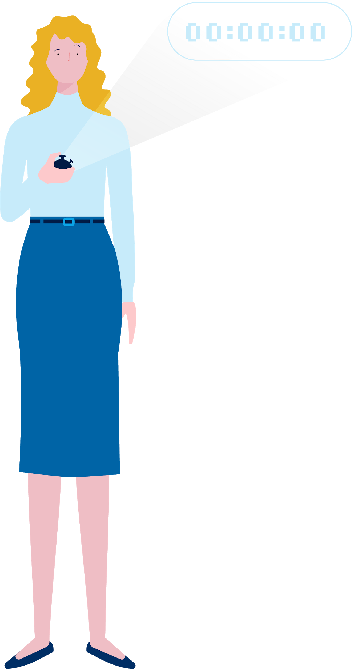
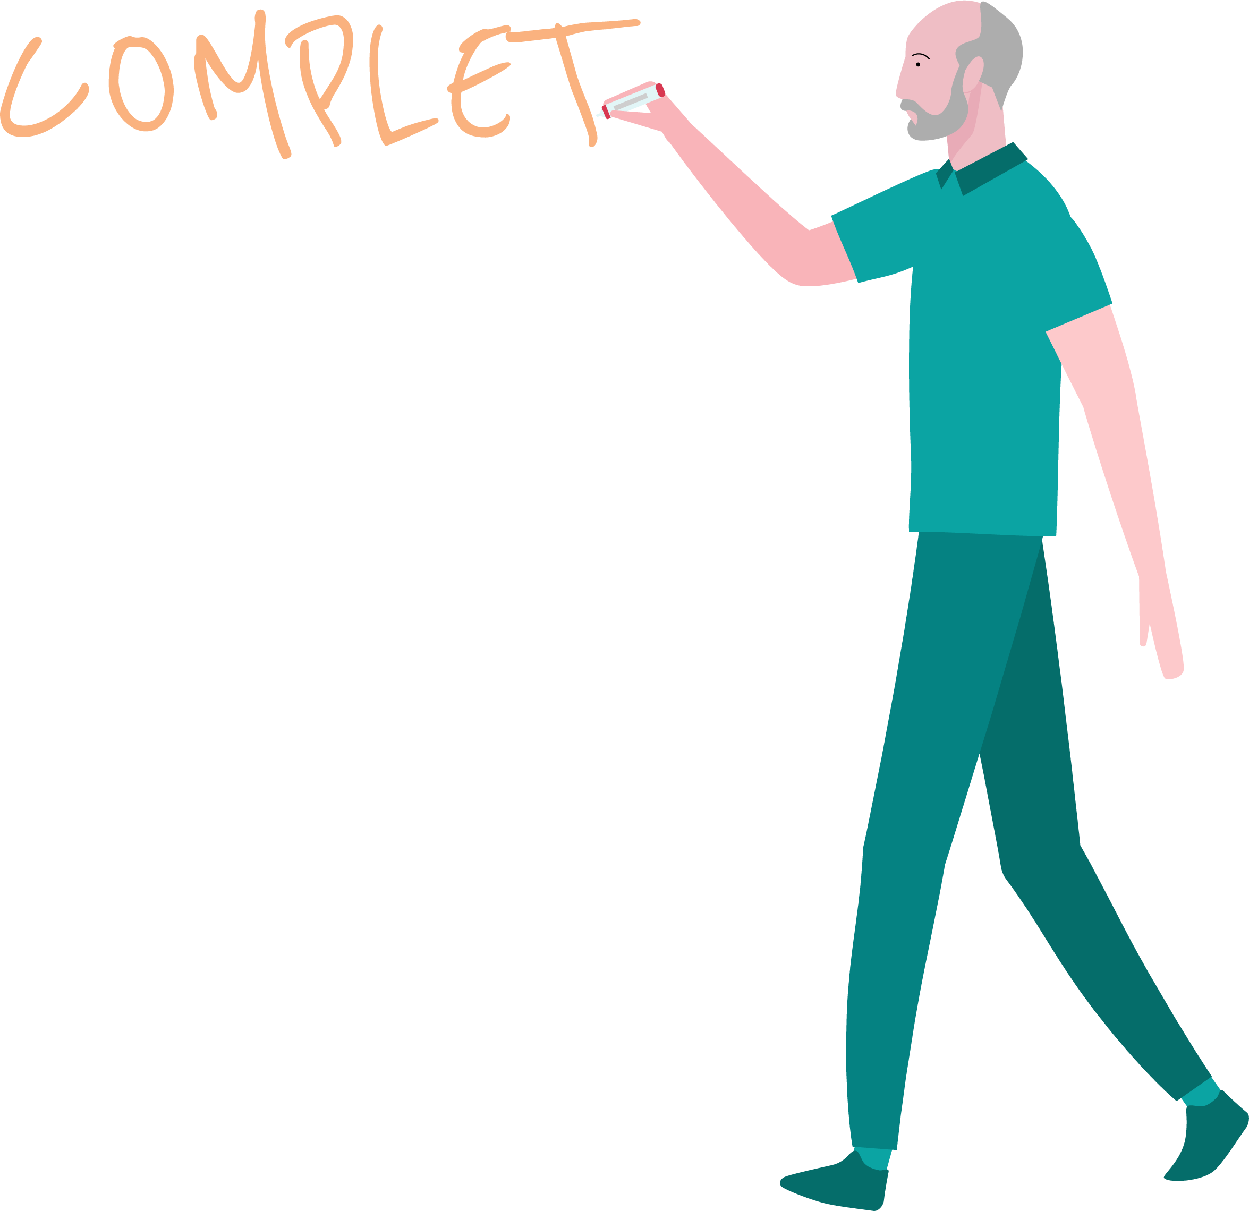
PONER LÍMITES DE TIEMPO
DIFERIR EL JUICIO
NO ROMPAS EL FLOW
CONSTRUIR EN EQUIPO
NO TE ENAMORES DE TUS IDEAS
ESCUCHA ACTIVA
FRASES COMPLETAS
DOCUMENTAR
Notes:
1/16 GOLDEN RULES FOR CREATING AS A TEAM / Overview of Golden Rules (20’)
You have mindset cards to apply the golden rules.

Slide 71
Poner límites de tiempo
Pon límites para maximizar la eficiencia
Notes:
11/16 GOLDEN RULES FOR CREATING AS A TEAM / Overview of Golden Rules (20’)
“Just in case this is a really spectacular idea we’re talking about, we drew it on a corner of a piece of paper and we’ve thrown it away.
Or we get: Hey, where’s that post-it where we’d written down the user’s needs really clearly and exactly as they said it?…
Let’s try not to lose anything along the way.
Working with ideas is very intangible so it’s important to be careful about what we tangibilize.”
[Mention the manual and suggest they use it as their scrapbook.]

Slide 72
Diferir el juicio
Divergencia
Convergencia
idear, abrir
evaluar, cerrar
DIFERIR EL JUICIO
Separa estos dos momentos conscientemente
Notes:
5/16 GOLDEN RULES FOR CREATING AS A TEAM / Overview of Golden Rules (20’)
There are two types of moments Diverge and Converge, and we’re going to separate them consciously.
[I explain briefly what diverge and converge mean and the need to defer judgment.]
“Our minds tend to do both things at the same time, open-close, open-close…
so we don’t have enough space to open up, we self-censor ourselves either consciously or unconsciously.
So the idea here is to become aware of this and gradually make the effort to defer judgment about our own and other people’s proposals.”

Slide 73
POR EJEMPLO:
¿Cómo podemos crear un banco para niños?
Notes:
6/16 GOLDEN RULES FOR CREATING AS A TEAM / Overview of Golden Rules (20’)
[I make them do a divergence, I note their ideas on a flipchart but I ABSOLUTELY DON’T respect any of the rules of divergence. I express judgments about what they say, I DON’T write down everything they say, I make killer statements…
I try to keep up the pressure until some of the participants start to criticize me.
And that’s when I stop and explain that I did exactly what you should never do.]
“OK, so what did I do that doesn’t work? What is it you shouldn’t do for a good divergence? ”

Slide 74
No rompas el flow
No uses frases matadoras
¿Conocéis alguna frase matadora?
Notes:
7/16 GOLDEN RULES FOR CREATING AS A TEAM / Overview of Golden Rules (20’)
“Do you know any killer phrases? You’re bound to have heard some sometimes…”
[I say all this with humor. I invite them to say more phrases. I propose some. I don’t write them down, we only say them.]

Slide 75
Don’t Break the Flow
Es una buena idea, pero…
Va contra la política del banco
Es buena en teoría. Sé más práctico
Eso es muy caro. No hay presupuesto
Nunca haremos algo así aquí. No lo van a querer
¿Por qué no lo ha hecho nadie antes si es tan buena idea?
Nunca lo hemos hecho así
No uses frases matadoras
Notes:
8/16 GOLDEN RULES FOR CREATING AS A TEAM / Overview of Golden Rules (20’)
Killer phrases break the flow of the creative process for everyone and for the team. They’re useless and damaging at moments of diversions.
“Here are some more examples in case we’ve forgotten.”

Slide 76
Construir en equipo
Una solución construida por distintas formas de pensar es más poderosa
Notes:
2/16 GOLDEN RULES FOR CREATING AS A TEAM / Overview of Golden Rules (20’)
“Even if I don’t like an idea, perfect, we write it down, and building on that idea… I say the opposite.
And crazy ideas are also very good for building on…”

Slide 77
No te enamores de tus ideas
Nos desconectamos de nuestras ideas
Enamórate del problema, no de la solución
Notes:
12/16 GOLDEN RULES FOR CREATING AS A TEAM / Overview of Golden Rules (20’)
“The idea is for us to be able to achieve a creative flow.
If I fall in love with my idea, I’m interrupting this flow and preventing myself and the others from advancing.
If each one of us tries to identify when this is happening to them, this is a luxury which means we can really move ahead…”

Slide 78
Escucha activa
¡Una conversación a la vez!
Notes:
3/16 GOLDEN RULES FOR CREATING AS A TEAM / Overview of Golden Rules (20’)
We don’t want to miss anything our teammate’s saying.
“It’s not a matter of demanding silence, but for everyone to listen to each other.
Because everyone has something to contribute and we don’t want to miss it.
And if some people find it harder to speak it’s important not to interrupt them
and to help each other to pay closer attention to each other.”

Slide 79
Usa frases completas
Hacemos tangible lo que decimos
Sujeto + verbo + predicado
Notes:
4/16 GOLDEN RULES FOR CREATING AS A TEAM / Overview of Golden Rules (20’)
“Just in case we come back tomorrow and we don’t understand what we meant by a single word like ‘autonomy or ‘sincerity’…
And also if another person joins it’s important for them to be able to understand what’s written or drawn on the post-its.
This is an additional effort that’s really worthwhile.
And it’s also the first way of learning to design…”

Slide 80
Documentar
Documentamos y tenemos la información bajo control
Notes:
9/16 GOLDEN RULES FOR CREATING AS A TEAM / Overview of Golden Rules (20’)
“Just in case this is a really spectacular idea we’re talking about, we drew it on a corner of a piece of paper and we’ve thrown it away.
Or we get: Hey, where’s that post-it where we’d written down the user’s needs really clearly and exactly as they said it?…
Let’s try not to lose anything along the way.
Working with ideas is very intangible so it’s important to be careful about what we tangibilize.”
[Mention the manual and suggest they use it as their scrapbook.]

Slide 81
Documentar
Nombre equipo
D1
Foto con nombre de herramienta
D2
Foto con nombre de herramienta
D3
D4
DOC con reto, nombre de solución y descripción corta de la solución
Notes:
10/16 GOLDEN RULES FOR CREATING AS A TEAM / Overview of Golden Rules (20’)
“Just in case this is a really spectacular idea we’re talking about, we drew it on a corner of a piece of paper and we’ve thrown it away.
Or we get: Hey, where’s that post-it where we’d written down the user’s needs really clearly and exactly as they said it?…
Let’s try not to lose anything along the way.
Working with ideas is very intangible so it’s important to be careful about what we tangibilize.”
[Mention the manual and suggest they use it as their scrapbook.]

Slide 82
Regla de oro EXTRA
+1
Notes:
13/16 GOLDEN RULES FOR CREATING AS A TEAM / Overview of Golden Rules (20’)

Slide 83
Failure is not a bug, it’s a feature
Notes:
14/16 GOLDEN RULES FOR CREATING AS A TEAM / Overview of Golden Rules (20’)
If you don’t fail, it most likely means that you are either not doing the process correctly or the solution is not very interesting/innovative
Failure, if taken correctly, allows us to really understand the the problem/solution fit and the user.

Slide 84
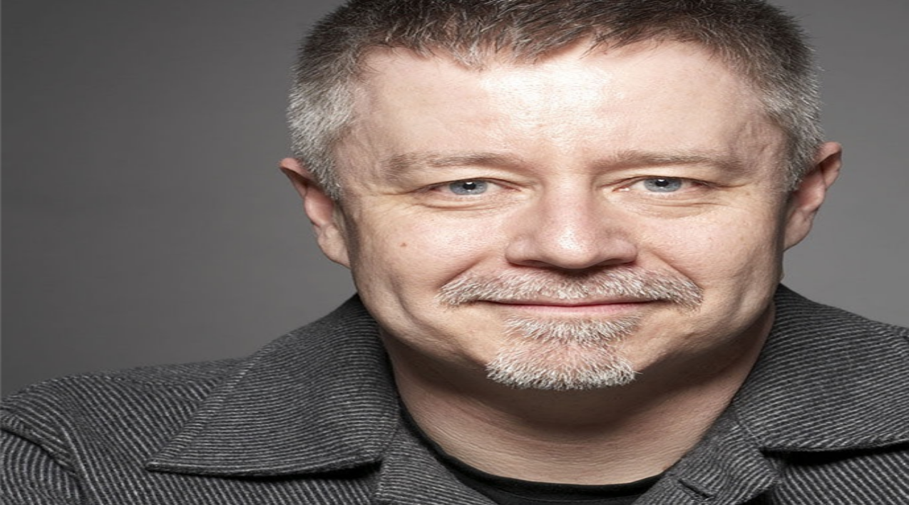
Es importante cometer errores
Fail early, fail cheap, and fail as many times as possible…
- Tim Brown, CEO de IDEO
pioneros en el Design Thinking
Y sigue aprendiendo…
Notes:
15/16 GOLDEN RULES FOR CREATING AS A TEAM / Overview of Golden Rules (20’)
[I read the quote in Spanish] “Fail early, fail cheap and fail as many times as possible. This is an invitation to make mistakes. In the process of making mistakes, there’s much to be learned. And because this is not a straight or scientific road, it is essential to be aware that errors are necessary and to accept that. It’s all part of the road.”

Slide 85
ACTIVIDAD:
¡Escoge tus reglas! 2´
Notes:
16/16 GOLDEN RULES FOR CREATING AS A TEAM / Overview of Golden Rules (20’)
2’ - everyone in the team chooses what Golden Rule they will be responsible for

Slide 86
Roles para crear en equipo
Notes:
1/3 GOLDEN RULES FOR CREATING AS A TEAM / Overview of Role Cards (10’)
“We’re going to see some rules that will be useful for the whole workshop.
We call them the golden rules because they’re simple and very powerful at the same time,
they capture the mindset, the “spirit” of Design Thinking and the attitude of the ’design thinker and ‘doer’.”

Slide 87
Dueño/s del problema
Contenido
Facilitador
Co-facilitador
Notes:
2/3 GOLDEN RULES FOR CREATING AS A TEAM / Overview of Role Cards (10’)
Here you can read the back of the role cards.
Facilitator: Guide, orient, listen, write, watch the time, propose tasks, invigorate, energize… You take on all the other roles and you’re responsible for making sure that the team can flow and create in a healthy and powerful way. This is a role for leadership and a lot of listening. You’re a channel to help the team create and be reinforced in their creativity. Of course it’s not a matter of imposing your ideas. In fact, although you can contribute your ideas, you may not have time to give them.
Co-facilitator: You support the facilitator in everything, particularly in listening, times, and practical aspects to maintain the flow… In a divergence, if you see the facilitator has been unable to pick up an idea, you remind them, and help them write everything down. You make sure the material is always ready so the facilitator can work. For example, if you’re making a divergence and writing things on a flipchart and the page comes to an end, you help by putting the sheet somewhere else, always within view of the team.
Owner of the problem: You’re the person responsible for the problem. You’re the one who brings everyone to the work session and proposes the goal of the session. The results of the session are going to be for you. You’ll have the last word at decision-making times in the session, as you’re going to be the most affected by whatever’s decided.
Content: Your role is to contribute your knowledge and experience to the work session. It’s important that you share what you know with the whole team and contribute to building a solution.

Slide 88
ACTIVIDAD:
¡Escoge tu rol!
2´
Notes:
3/3 GOLDEN RULES FOR CREATING AS A TEAM / Overview of Role Cards (10’)
3’ - everyone in the team chooses what Role they will play. Mention that the facilitator role will rotate over the course of the workshop so everyone can have a chance at it

Slide 89
A por un café
15’
Notes:
BREAK - 25’

Slide 90
Comprensión
Notes:
14 SLIDES UNDERSTANDING PHASE (15’)
“Called Design Research in the literature… if you want to read more about the subject.”

Slide 91
Evaluar
Comprender
con clientes reales para asegurarnos de que nuestra solución cubre sus necesidades.
las necesidades y comportamientos reales para descubrir nuevas oportunidades e identificar el problema a resolver.
Prototipar
Idear
modelos comprobables para iterar rápidamente y mejorar nuestras soluciones.
tantas ideas de solución como sea posible para elegir la mejor y construirla.
Notes:
1/14 UNDERSTANDING PHASE / Overview of the Understanding Phase (3’)
We’re going to research to try and understand the needs of our customers
You’ve already started doing the pre-task
By the way, how did it go? Who was able to do it?
If you weren’t able to do it, don’t worry because today we’re going to do more things.

Slide 92
Comprensión
¿Por qué investigamos antes de crear?
Notes:
2/14 UNDERSTANDING PHASE / ASK: Why do we research before creating? (7’)
[I ask everyone there and note down their answers.]

Slide 93
Debes entender el problema antes de solucionarlo
Notes:
3/14 UNDERSTANDING PHASE / ASK: Why do we research before creating? (7’)

Slide 94
La comprensión nos lleva a la empatía y a los hallazgos…
Notes:
4/14 UNDERSTANDING PHASE / ASK: Why do we research before creating? (7’)

Slide 95
…permitiéndonos tomar decisiones clave cuando el coste del cambio es todavía muy bajo
Implementación
Desarrollo
Costes y esfuerzos
Tiempo y recursos
Coste del cambio
Prototipo
Comprender las necesidades del usuario
Concepto
Definición
Ejecución
Notes:
5/14 UNDERSTANDING PHASE / ASK: Why do we research before creating? (7’)
Throughout the project the cost of change increases.
If we have our customers’ needs clear from the start and we work to resolve them, we mitigate risk and we can create much more valuable offers.

Slide 96
Necesitamos comprender los 3 aspectos de nuestro proyecto
¿Cómo ha evolucionado el mercado?
¿Hay alguna oportunidad de negocio?
Negocio
¿Qué es importante para nuestros usuarios?
¿Qué necesitan?
¿Por qué?
¿Cómo puede la tecnología ayudarnos a solucionar problemas?
¿Cómo evolucionarán esas tecnologías?
Experiencia
Tecnología
Notes:
6/14 UNDERSTANDING PHASE / ASK: Why do we research before creating? (7’)
Tecnologia: diferencia entre innovar e inventar.

Slide 97
Comprensión
Nos vamos a centrar en la investigación de usuarios
Notes:
7/14 UNDERSTANDING PHASE / ASK: Why do we research before creating? (7’)

Slide 98
¿Investigación cualitativa o cuantitativa?
Cuantitativa
Cualitativa
Nos permite comprender qué, quién, dónde y cuándo
Nos da una perspectiva para enfocar la investigación cualitativa
Nos permite comprender por qué os da una comprensión más profunda y completa de los problemas a resolver
Notes:
8/14 UNDERSTANDING PHASE / ASK: Why do we research before creating? (7’)

Slide 99
No debemos seguir adelante sin investigación cualitativa.
No debemos seguir adelante sin investigación cualitativa
Notes:
9/14 UNDERSTANDING PHASE / ASK: Why do we research before creating? (7’)

Slide 100
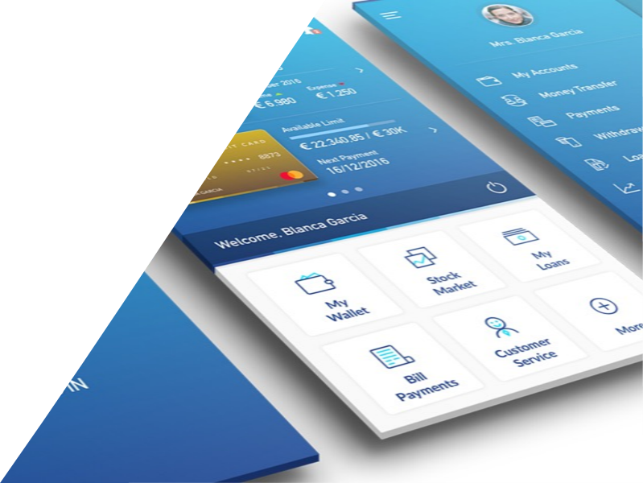
Cuantitativa
En una primera versión de la página para abrir una cuenta nómina, un análisis cuantitativo nos dio una alta tasa de abandona en los pasos 3 y 4 del proceso de alta
Notes:
10/14 UNDERSTANDING PHASE / ASK: Why do we research before creating? (7’)
Proceso de ALTA de cuenta nómina:
En la primera versión de alta on-line, se dieron cuenta que en el paso 3 y 4 la gente abandonaba el proceso. Eso se lo dieron los datos cuantitativos.
Pero no sabían el por qué. La gente después de una mala experiencia no estaba para darles su opinión.
Fue mediante entrevistas contextuales que empezaron a comprender que eran los datos que se les solicitaban (se les pedía en SENAE) y otros temas lo que les echaban para atrás y decidían abandonar el proceso.
El quanti puso el foco pero fue el cual el que permitió saber qué, como y porqué sucedía.

Slide 101
Cualitativa
Al complementar este estudio con entrevistas, pudimos darnos cuenta de donde radicaba el problema:
Los datos requeridos para completar el alta eran tan complicados de conseguir que conducían al abandono del proceso
Notes:
11/14 UNDERSTANDING PHASE / ASK: Why do we research before creating? (7’)

Slide 102
Hay muchas maneras de hacer investigación cualitativa
Observar y escuchar
Co-crear
Entrevistar
Notes:
12/14 UNDERSTANDING PHASE / ASK: Why do we research before creating? (7’)
“Between these 3 activities, we have plenty of hybrid techniques”

Slide 103
PREPARACIÓN
TRABAJO DE CAMPO
ANÁLISIS Y SÍNTESIS
Planificar la investigación
Coordinación y reclutamiento
Tareas del campo
Conservar datos
Construir información
Dar sentido a la investigación
Notes:
13/14 UNDERSTANDING PHASE / Research in the Design Thinking Process (5’)
“Research requires the following steps.
On this course we’re going to speed it up.
We’re not going to go into detail.
You have it all here in your manual if you want to take a closer look.”
Plan the research
Define the aims of the research
Share the situation at the outset.
Identify the information needed.
Choose which techniques/tools to use.
Coordination and recruitment
Identify who can be the interviewees.
Contact the interviewees and schedule the interviews, diaries etc.
Fieldwork Tasks
Speak, listen, observe and collect data.
Saving the Data
Download the data that have just been learned, transfer them to notes or post-its.
Make sure all the data and documents collected are being saved.
Build Information
Transform the data into information.
Give meaning to the research subject
Transform the information into knowledge. Identify the insights.

Slide 104
PREPARACIÓN
TRABAJO DE CAMPO
ANÁLISIS Y SÍNTESIS
Planificar la investigación
Coordinación y reclutamiento
Tareas del campo
Conservar datos
Construir información
Dar sentido a la investigación
¿Qué objetivos tenemos?
¿A quién vamos a entrevistar?
Entrevista
Compartir, volcar y organizar los datos
Categorizar
Identificar Insights y Oportunidades
Mapa de ecosistema
Persona y Journey Map
Notes:
13/14 UNDERSTANDING PHASE / Research in the Design Thinking Process (5’)
“Research requires the following steps.
On this course we’re going to speed it up.
We’re not going to go into detail.
You have it all here in your manual if you want to take a closer look.”
Plan the research
Define the aims of the research
Share the situation at the outset.
Identify the information needed.
Choose which techniques/tools to use.
Coordination and recruitment
Identify who can be the interviewees.
Contact the interviewees and schedule the interviews, diaries etc.
Fieldwork Tasks
Speak, listen, observe and collect data.
Saving the Data
Download the data that have just been learned, transfer them to notes or post-its.
Make sure all the data and documents collected are being saved.
Build Information
Transform the data into information.
Give meaning to the research subject
Transform the information into knowledge. Identify the insights.

Slide 105
Comparte y organiza los datos de la investigación
Notes:
3 SLIDES SHARING + POOLING PRE-TASK (30’)

Slide 106
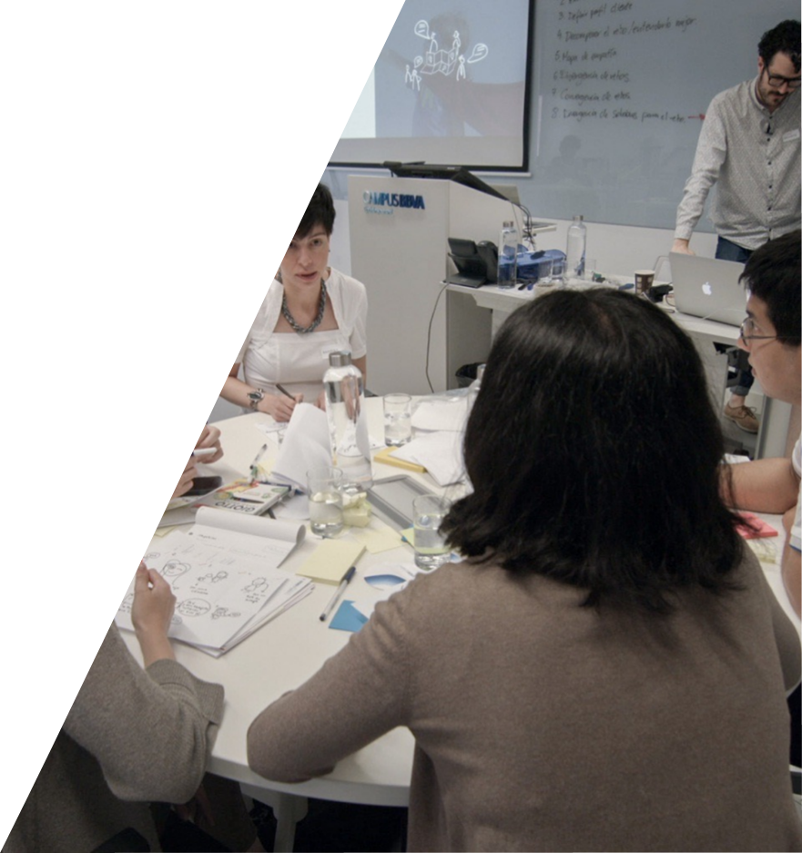
¿Por qué?
Compartimos la investigación elaborada por cada miembro del equipo para alinear todo lo aprendido hasta el momento
Notes:
1/3 SHARING + POOLING THE PRE-TASK / Overview of Aligning the Knowledge (3’)
A key step before beginning to analyze in teams is to share all the work each person has done (in this case, in the pre-task) with the rest of the team to align all the knowledge available on the project.

Slide 107
¿Cómo organizamos los datos?
1 hecho, 1 post-it
Escribe entre comillas las citas textuales
Identifica la fuente
Usa rotuladores
Usa las reglas de oro
Notes:
2/3 SHARING + POOLING PRE-TASK / GROUP: Share + Pooling Pre-Task (27’)
How do we do it?
Use only one post-it for each piece of data. If everything’s separate, it’ll be easier to use the our data to analyze.
Write any verbatim quotes your interviewees have told you between inverted commas . Add the person who said it.
Identify each post-it with its source. That way you can go back to the original document if you need to.
Use the golden rules.
Use a marker pen. You won’t be able to see ballpoint or pencil in the photos of the post-its to document it later.

Slide 108
Actividad
Organizar los datos
Cada miembro del equipo comparte sus notas (5’)
El resto del equipo escucha activamente
Al escuchar, apuntamos lo que nos llama la atención en post-its
¡No discutimos lo que escuchamos! ¡No se emiten juicios!
La redundancia puede ser interesante
35’
Notes:
3/3 SHARING + POOLING PRE-TASK / GROUP: Share + Pooling Pre-Task (27’)
How do we do it?
Everyone has 5’ to explain what they did in their pre-task. You can use the notes you took and the sheet you filled out after doing the pre-task.
Everyone else listens and take notes of things that grab their attention.
This is not the time to discuss what we hear. Right now we’re in divergence and all the data are of interest to us, even those we think are redundant.

Slide 109
Categorizar los datos
Notes:
4 SLIDES CLUSTERING DATA (50’)

Slide 110
PREPARACIÓN
TRABAJO DE CAMPO
ANÁLISIS Y SÍNTESIS
Planificar la investigación
Coordinación y reclutamiento
Tareas del campo
Conservar datos
Construir información
Dar sentido a la investigación
¿Qué objetivos tenemos?
¿A quién vamos a entrevistar?
Entrevista
Compartir, volcar y organizar los datos
Categorizar
Identificar Insights y Oportunidades
Mapa de ecosistema
Persona y Journey Map
Notes:
1/4 SHARING + POOLING THE PRE-TASK / Overview of Aligning the Knowledge (3’)
A key step before beginning to analyze in teams is to share all the work each person has done (in this case, in the pre-task) with the rest of the team to align all the knowledge available on the project.

Slide 111
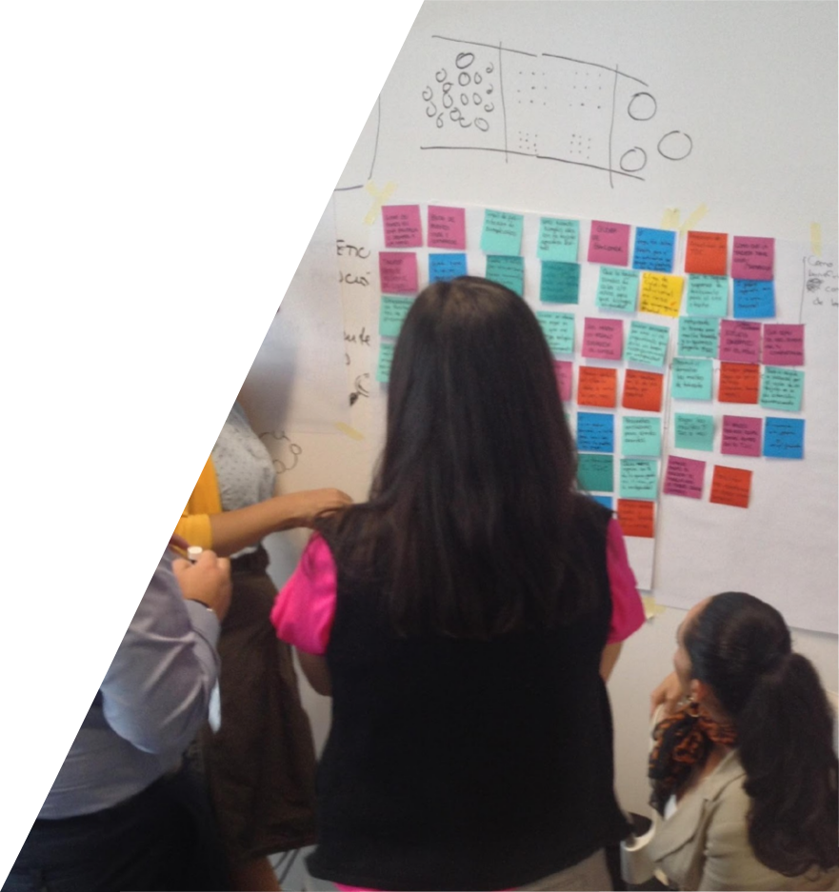
¿Por qué?
Para poder trabajar con los hechos que hemos observado, debemos ser capaces de entenderlos de un vistazo
Notes:
2/4 CLUSTERING DATA / Overview of Clustering Data (5’)
If we want to be able to work with all the information produced, we need to have it in plain view.
What were going to do now is to finish transferring all the data we’ve obtained in our fieldwork on to post-its, so when we have everything in view, we can begin to analyze and see connections between them.

Slide 112
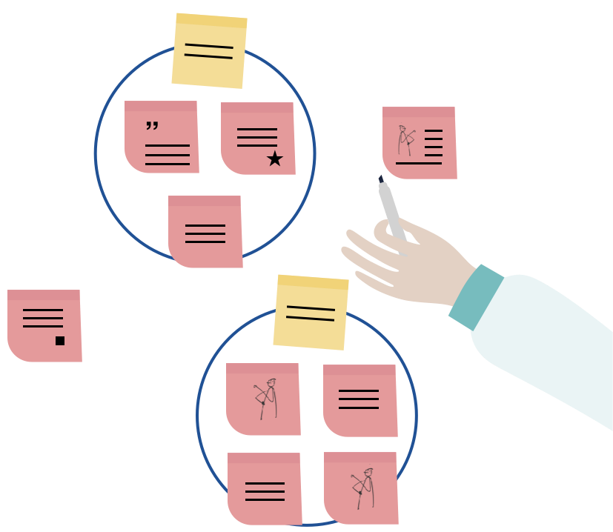
¿Cómo categorizamos los datos?
Agrupa ideas que son similares
Da un nombre a cada categoría
Reagrúpalos tantas veces como sea necesario; es un proceso iterativo
No fuerces valores aislados en grupos construidos
Notes:
3/4 CLUSTERING DATA / Overview of Clustering Data (5’)
How do we do it?
We begin to group together the post-its we identify as being connected in some way.
We give each group or category a name.
We regroup as often as necessary until the whole team feels comfortable.
We can begin to discard post-its, as we’re in Convergence.

Slide 113
Actividad
Categorizar datos
10’
35’
Pega los post-its
Genera grupos y conexiones
”
Notes:
4/4 CLUSTERING DATA / Clustering Data (45’)

Slide 114
¡A comer!
60’
Notes:
LUNCH 75 MINUTES

Slide 115
ACTIVIDAD:
Calentamiento
Notes:
ENERGIZER 15 MINUTES

Slide 116
Mapa de ecosistema
Notes:
7 SLIDES ECOSYSTEM MAP (50’)

Slide 117
PREPARACIÓN
TRABAJO DE CAMPO
ANÁLISIS Y SÍNTESIS
Planificar la investigación
Coordinación y reclutamiento
Tareas del campo
Conservar datos
Construir información
Dar sentido a la investigación
¿Qué objetivos tenemos?
¿A quién vamos a entrevistar?
Entrevista
Compartir, volcar y organizar los datos
Categorizar
Identificar Insights y Oportunidades
Mapa de ecosistema
Persona y Journey Map
Notes:
1/7 ECOSYSTEM MAP / Overview of the Ecosystem Map (5’)

Slide 118
¿Qué es?
P. 74
Una representación visual de las conexiones entre los distintos actores que están vinculados a la problemática que nos ocupa
Notes:
2/7 ECOSYSTEM MAP / Overview of the Ecosystem Map (5’)
The ecosystem map is a visual representation of the different actors involved in the situation we’re working with.
It also shows the connections between them.
The “actors” may be the people in an organization, users, customers, companies, public or private organizations, the departments in a company, and others.

Slide 119
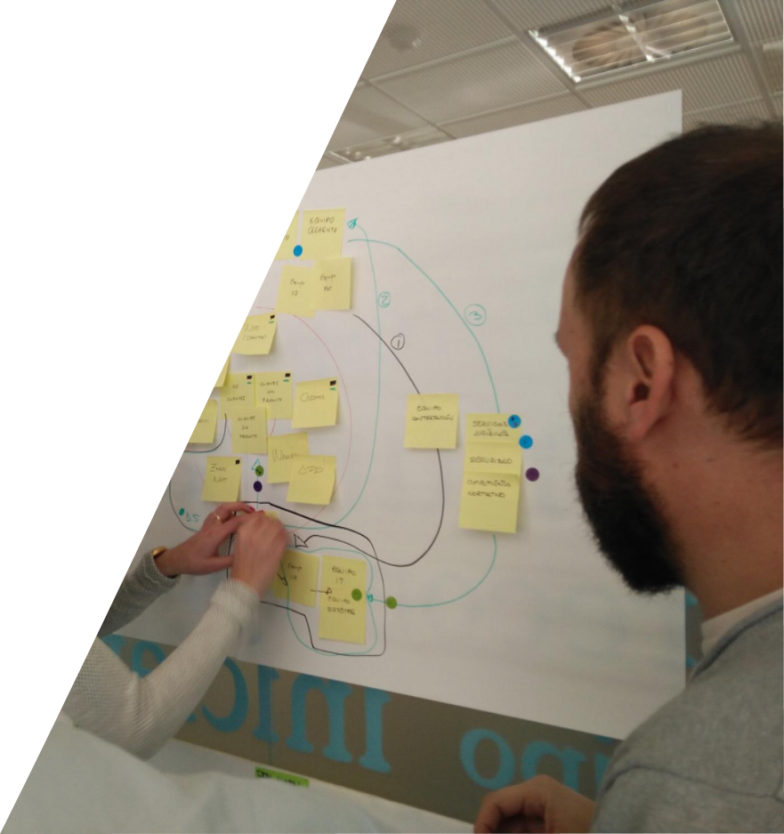
¿Por qué?
Nos permite identificar actores clave
Dibuja sus relaciones
Entendemos mejor el entorno
Jerarquiza relaciones
Nos ayuda a imaginar sinergias y nuevas ideas
Notes:
3/7 ECOSYSTEM MAP / Overview of the Ecosystem Map (5’)
To identify, analyze and understand better the relationships and exchanges between the different actors. It also allows us to reflect on the actors that are not initially so obvious when beginning to work on a challenge.
It helps us to:
What’s it for?
Identify key actors
Establish their relations
Understand
Prioritize
Ideate possible synergies and collaborations.

Slide 120
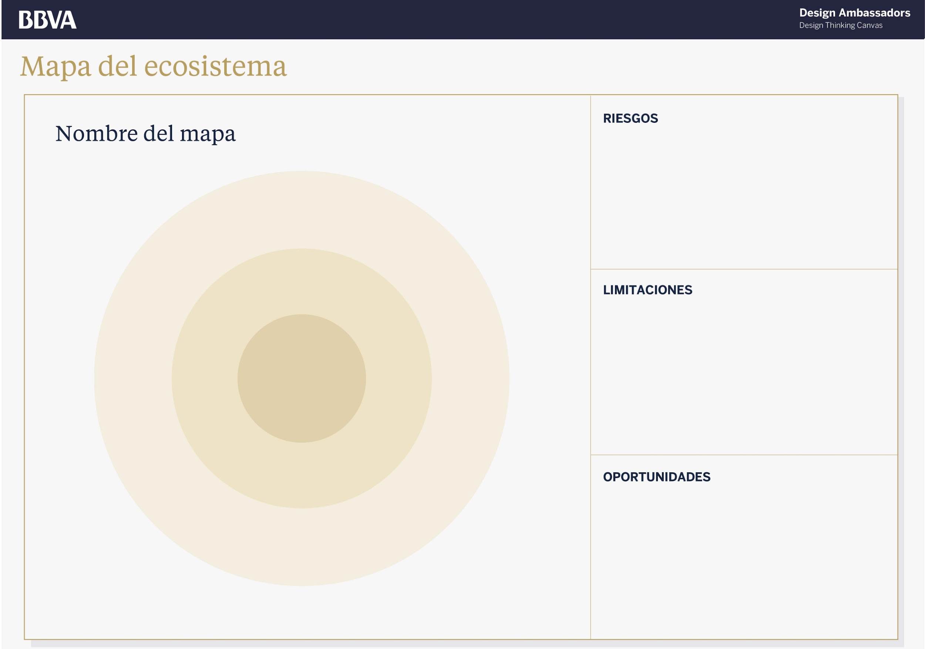
¿Cómo?
P. 74
Identifica los actores claves
Coloca al actor principal en el centro del mapa
Coloca el resto de actores en el mapa según su importancia
Agrúpalos por relación, canal o intercambio de valor
Anota los conflictos, riesgos, limitaciones u oportunidades que identificas
Notes:
4/7 ECOSYSTEM MAP / Overview of the Ecosystem Map (5’)
To begin with, you can make a divergence of actors related to the problem.
Identify the main actors in our problem: people, departments, companies etc…
Locate on the map, placing the main actor in the center and arranging the other actors around it.
It represents the relationships established between them, the exchange of value and the channels they use.
Write on a sheet of paper beside it the conflicts, risks, limitations and opportunities you identify.
Highlight the most significant elements.
How is it built?
Identify the key actors
Place them on the map
Draw the relationships between them
Detail the conflicts, risks, limitations and opportunities you identify on another page.
Highlight the most significant elements.

Slide 121
EJEMPLO:
Un nuevo hotel Mercer 5 estrellas
Notes:
5/7 ECOSYSTEM MAP / EXAMPLE: Mercer 5-Star Hotel (10’)
Imagine a new 5-star hotel in a historic neighborhood recently going through gentrification

Slide 122
Ecosystem Map
Notes:
6/7 ECOSYSTEM MAP / EXAMPLE: Mercer 5-Star Hotel (10’)
Imagine a new 5-star hotel in a historic neighborhood recently going through gentrification

Slide 123
Actividad
30’
Identifica los actores claves
Coloca al actor principal en el centro del mapa
Coloca el resto de actores en el mapa según su importancia
Agrúpalos por relación, canal o intercambio de valor
Anota los conflictos, riesgos, limitaciones u oportunidades que identificas
Notes:
7/7 ECOSYSTEM MAP / GROUP: Ecosystem Map (30’)
To begin with, you can make a divergence of actors related to the problem.
Identify the main actors in our problem: people, departments, companies etc…
Locate on the map, placing the main actor in the center and arranging the other actors around it.
It represents the relationships established between them, the exchange of value and the channels they use.
Write on a sheet of paper beside it the conflicts, risks, limitations and opportunities you identify.
Highlight the most significant elements.
How is it built?
Identify the key actors
Place them on the map
Draw the relationships between them
Detail the conflicts, risks, limitations and opportunities you identify on another page.
Highlight the most significant elements.

Slide 124
Market Trends

Slide 125
PREPARATION
FIELDWORK
ANALYSIS AND SYNTHESIS
Plan Research
Coordination
and Recruitment
Fieldwork Tasks
Save Data
Build
Information
Give meaning to the research subject
What are the objectives?
Who will you interview?
Interview
Share, Note +
Pool Data
Clustering
Identify Insights + Opportunities
Market Trends + Forces
Persona + Journey

Slide 126
What is it?
P. 69
…A visual overview of the main forces and trends affecting the market you’re design for

Slide 127
Why?
Paint an overview of the industry
Starting point for exploring
Comprehend
Prioritise
Come up with possible synergies and ideas

Slide 128
Market + Trend Map

Slide 129
Market + Trend Map
Identify Industry Forces

Slide 130
Market + Trend Map
Identify main Market Forces

Slide 131
Market + Trend Map
Identify Macro-Economic Forces

Slide 132
Market + Trend Map
Core Issues immediately affects or threatens the project

Slide 133
Market + Trend Map
Peripheral Issues might lead to new, innovative insights

Slide 134
Ejemplo:
A New Mercer 5 - Star Hotel

Slide 135
Market + Trend Map

Slide 136
ACTIVIDAD:
Market Trends + Forces Map

Slide 137
Market + Trend Map
30’

Slide 138
Persona
Notes:
19 SLIDES PERSONA (45’)

Slide 139
PREPARACIÓN
TRABAJO DE CAMPO
ANÁLISIS Y SÍNTESIS
Planificar la investigación
Coordinación y reclutamiento
Tareas del campo
Conservar datos
Construir información
Dar sentido a la investigación
¿Qué objetivos tenemos?
¿A quién vamos a entrevistar?
Entrevista
Compartir, volcar y organizar los datos
Categorizar
Identificar Insights y Oportunidades
Mapa de ecosistema
Persona y Journey Map
Notes:
1/19 PERSONA / Overview of the Persona (10’)

Slide 140
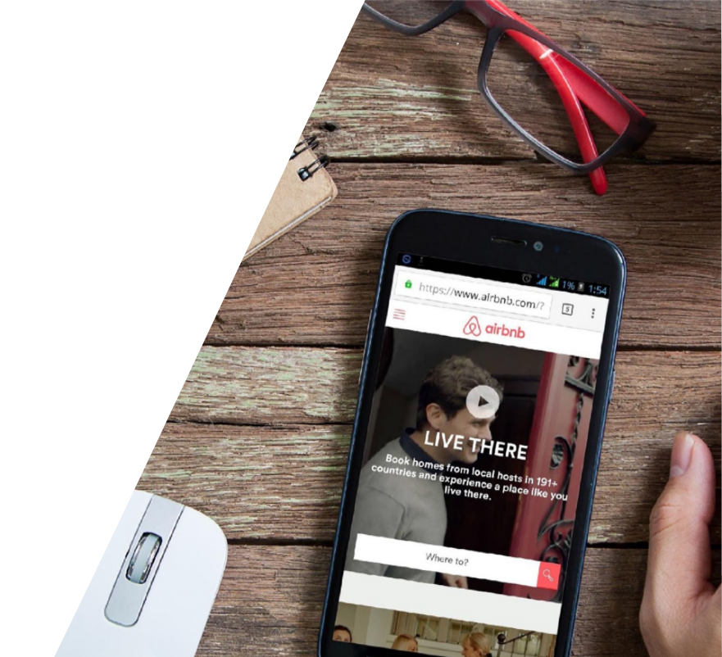
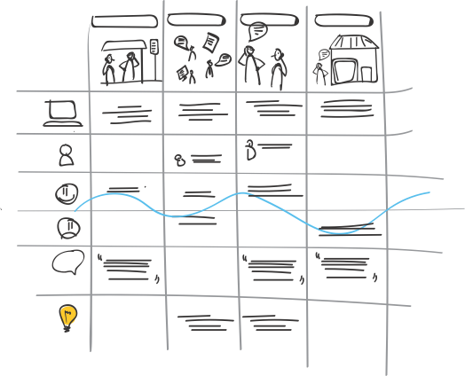
¿Qué es una Persona?
Notes:
2/19 PERSONA / Overview of the Persona (10’)

Slide 141
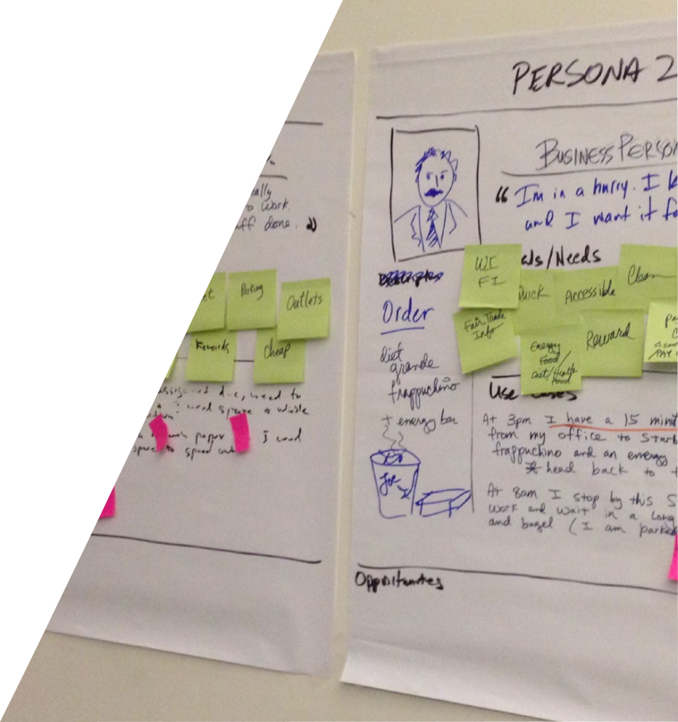
¿Qué es?
P. 90
Una ficha descriptiva de nuestro usuario
Una descripción creíble de un posible cliente, detallando su manera de pensar
Notes:
3/19 PERSONA / Overview of the Persona (10’)
A Persona is a design tool consisting of making a representation of a person, possible user, with certain characteristics that represents a group of users according to their needs and behaviors. It is built based on the lessons learned from the research.

Slide 142
¿Qué características definimos?
Historia personal, momento vital
Hábitos, actitudes, reacciones, relaciones
Deseos, principios personales, razones, necesidades, problemas
Objetivos vitales relacionados con el contexto del proyecto
Cualquier cosa que creas que puede ser útil saber
Notes:
4/19 PERSONA / Overview of the Persona (10’)
A Persona is a design tool consisting of making a representation of a person, possible user, with certain characteristics that represents a group of users according to their needs and behaviors. It is built based on the lessons learned from the research.

Slide 143
¿Por qué?
Para generar empatía con el usuario
Para dirigir el proceso de diseño
Para generar consenso y compromiso en el equipo
Para estimular la creatividad y alejarnos de creencias y prejuicios
Para evaluar la eficacia de un diseño
Como una herramienta narrativa
Notes:
5/19 PERSONA / Overview of the Persona (10’)
What’s the point of a Persona?
To synthesize learnings from Design Research
To generate empathy with the users
To direct the design and product/service
To stimulate the team’s creativity, help break molds or prejudices or beliefs,
To bear in mind the learnings from the research
To start a conversation around the design
As a tool for storytelling
To generate agreements and compromise with the design
To test the efficacy of a design
What’s the point of a Persona?

Slide 144
HERRAMIENTA:
Persona
Notes:
6/19 PERSONA / Overview of the Persona (10’)

Slide 145
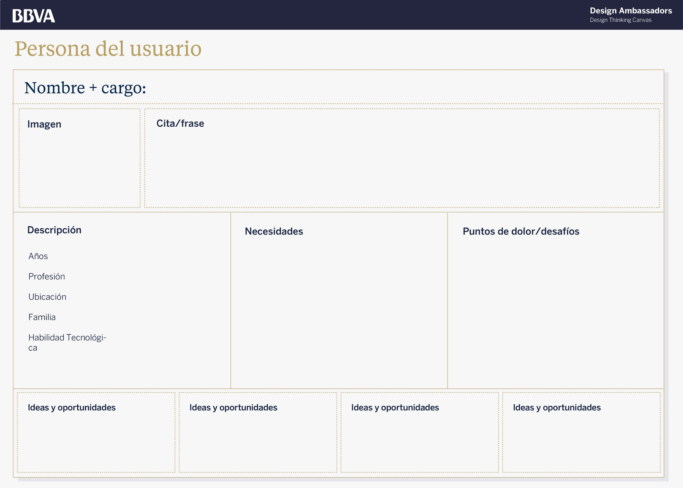
User Persona
Notes:
7/19 PERSONA / Overview of the Persona (10’)

Slide 146
User Persona
Notes:
8/19 PERSONA / EXAMPLE: BBVA Persona (5’)

Slide 147
User Persona
Nombre y título de la Persona
Notes:
9/19 PERSONA / EXAMPLE: BBVA Persona (5’)

Slide 148
User Persona
Foto o dibujo de la Persona
Notes:
10/19 PERSONA / EXAMPLE: BBVA Persona (5’)

Slide 149
User Persona
Frase relevante de la Persona
Notes:
11/19 PERSONA / EXAMPLE: BBVA Persona (5’)

Slide 150
User Persona
Una descripción breve con detalles relevantes
Notes:
12/19 PERSONA / EXAMPLE: BBVA Persona (5’)

Slide 151
User Persona
Una descripción de sus necesidades y preocupaciones
Notes:
13/19 PERSONA / EXAMPLE: BBVA Persona (5’)

Slide 152
User Persona
¿Cuáles son sus retos y puntos de dolor?
Notes:
14/19 PERSONA / EXAMPLE: BBVA Persona (5’)

Slide 153
User Persona
Insights y oportunidades
(mañana)
Notes:
15/19 PERSONA / EXAMPLE: BBVA Persona (5’)

Slide 154
ACTIVIDAD:
Persona
Notes:
16/19 PERSONA / EXAMPLE: BBVA Persona (5’)

Slide 155
¿Cómo?
P. 90
Identifica patrones observados en la investigación
Decide cuántas personas son necesarias
Añade nombre y título
Incluye una foto o dibujo en la Persona
Resume la manera de pensar de tu Persona
Añade una descripción personal
Describe sus necesidades y objetivos
Describe sus frustraciones y retos
Notes:
17/19 PERSONA / GROUP: Persona (30’)

Slide 156
Consejos
Utiliza las reglas de oro
Básala en una (o varias) persona(s) real(es)
Empatiza con el/la
Crea una historia que os creáis como equipo
Usa Visual Thinking y dibuja tus ideas
Muévete y actúa como tu Persona
Escribe frases completas
Notes:
18/19 PERSONA / GROUP: Persona (30’)

Slide 157
Actividad
P. 90
30’
Identifica patrones observados en la investigación
Decide cuántas personas son necesarias
Añade nombre y título
Incluye una foto o dibujo en la Persona
Resume la manera de pensar de tu Persona
Añade una descripción personal
Describe sus necesidades y objetivos
Describe sus frustraciones y retos
Notes:
19/19 PERSONA / GROUP: Persona (30’)

Slide 158
Journey Map
Notes:
13 SLIDES JOURNEY (50’)
[We all get up and move toward the prepared flipcharts to make the journey. I ask volunteers to do the work as I guide them:
one person to describe the moments
another person to draw them
another person to draw the contact points (evidences of the service)
another person for the emotions.
another for the thoughts
etc.
We do it all really quickly, ideally in 10 minutes]

Slide 159
Ejemplo:
Vamos a
tomar un café
Notes:
1/13 JOURNEY / EXAMPLE: Starbucks (10’)
[We all get up and move toward the prepared flipcharts to make the journey. I ask volunteers to do the work as I guide them:
one person to describe the moments
another person to draw them
another person to draw the contact points (evidences of the service)
another person for the emotions.
another for the thoughts
etc.
We do it all really quickly, ideally in 10 minutes]

Slide 160
What is it?
P. 94
Una representación gráfica de la experiencia de usuario de un producto o servicio a lo largo del tiempo, desde la perspectiva de la Persona
Notes:
2/13 JOURNEY / Overview of the Journey Map (5’)
This is a representation of the experience of a user over time, from their point of view.
It allows us to visualize all the steps in the experience along a time axis. It captures what the customer does, thinks and feels at any time to understand the opportunities it presents.
It helps us identify relevant actors and artifacts, critical points, moments of truth, opportunities for improvement.
It can be shown in several formats as long as it always follows a timeline.

Slide 161
¿Por qué?
Nos permite visualizar toda la experiencia del usuario a lo largo del tiempo
Captura lo que el usuario hace, piensa y siente en momentos concretos
Ayuda a identificar actores y artefactos relevantes, momentos críticos y oportunidades
Notes:
3/13 JOURNEY / Overview of the Journey Map (5’)

Slide 162
Journey Map
Notes:
4/13 JOURNEY / Overview of the Journey Map (5’)
Let’s walk through the Journey Map with the example challenge.

Slide 163
Journey Map
La situación que estamos describiendo
Notes:
5/13 JOURNEY / Overview of the Journey Map (5’)

Slide 164
Journey Map
Una descripción visual y/o escrita del momento que vive el usuario desde su punto de vista
Notes:
6/13 JOURNEY / Overview of the Journey Map (5’)

Slide 165
Journey Map
El pensamiento y las emociones del usuario
Notes:
7/13 JOURNEY / Overview of the Journey Map (5’)

Slide 166
Journey Map
Aspectos positivos y negativos de la experiencia
Notes:
8/13 JOURNEY / Overview of the Journey Map (5’)

Slide 167
Journey Map
Insights y oportunidades (mañana)
Notes:
9/13 JOURNEY / Overview of the Journey Map (5’)

Slide 168
¿Cómo?
P. 94
Selecciona la Persona
Define la situación que te interesa dibujar
Escribe titulares que describan cada momento en el que se encuentra el usuario
Escribe y dibuja una descripción de cada momento
Identifica puntos positivos y puntos de dolor
Notes:
10/13 JOURNEY / GROUP: Journey Map (35’)
Comentarios de Marcela:
Comenzar de lo general a lo particular, poner primero todos lo momentos, luego la historia del cliente, debe de ser siempre siempre en primera persona ;), luego emociones y artefactos.

Slide 169
Consejos
Usa tu Persona y empatiza con ella
Crea una historia que el equipo se crea
Empieza con los grandes momentos y trabaja luego los detalles
Usa el Visual Thinking
Usa las reglas de oro
Escribe frases completas
Notes:
11/13 JOURNEY / GROUP: Journey Map (35’)

Slide 170
Actividad
P. 94
Selecciona la Persona
Define la situación que te interesa dibujar
Escribe titulares que describan cada momento en el que se encuentra el usuario
Escribe y dibuja una descripción de cada momento
Identifica puntos positivos y puntos de dolor
Notes:
12/13 JOURNEY / GROUP: Journey Map (35’)

Slide 171
PREPARACIÓN
TRABAJO DE CAMPO
ANÁLISIS Y SÍNTESIS
Planificar la investigación
Coordinación y reclutamiento
Tareas del campo
Conservar datos
Construir información
Dar sentido a la investigación
¿Qué objetivos tenemos?
¿A quién vamos a entrevistar?
Entrevista
Compartir, volcar y organizar los datos
Categorizar
Identificar Insights y Oportunidades
Mapa de ecosistema
Persona y Journey Map
Notes:
1/19 PERSONA / Overview of the Persona (10’)

Slide 172
Compartimos al final del día
Notes:
6 SLIDES LEARNINGS AND SHARE OUT (50’)

Slide 173
Learn
Do
Teach
Notes:
1/6 LEARN. DO. TEACH
One of the commitments of Ambassadors is to share their knowledge.
We as designers have to build moments of teaching our way of working in order to make people understand the value and impact we are able to add.
We are going to have some moments to work on the skills needed to be effective communicators to our colleagues and be able to share, out in the field, the learnings of this 4 day workshop.

Slide 174
Actividad
60’
Explica una herramienta o regla de oro
¿Qué es?
¿Por qué es útil?
¿Necesitas hacer algo antes de usarla?
¿Cómo/cuándo la puedes usar en tu día a día?
Notes:
2/6 LEARN. DO. TEACH. Exercise.
One of the commitments of Ambassadors is to share their knowledge.
We as designers have to build moments of teaching our way of working in order to make people understand the value and impact we are able to add.
We are going to have some moments to work on the skills needed to be effective communicators to our colleagues and be able to share, out in the field, the learnings of this 4 day workshop.

Slide 175
Feedback y
limpieza del espacio de trabajo
Feedback y limpieza del espacio de trabajo
Notes:
3/6 LEARN. DO. TEACH. Exercise.
[I ask and write it down on the flipchart:]
What have we learned today?
How did you feel about the exercises?
What did they contribute to you?

Slide 176
Feedback, preguntas y respuestas
3’
Por parejas, anotad vuestros aprendizajes en las páginas finales de vuestro manual
Notes:
4/6 LESSONS LEARNED
INDIVIDUALLY: Write your learnings in page… of your manual.

Slide 177
Entramos en G+
Asegúrate que estás en la comunidad y comparte tus iniciativas de transformación
Notes:
5/6 GOOGLE + COMMUNITY
Enlace para invitar: https://plus.google.com/communities/101178540204203299975?sqinv=akQzRzVRZmxHTHZYMFVlQk52akJJQnNpdkRZSlZB
…

Slide 178
Recuerda
Nombre de equipo
Doc de texto con reto, nombre de la solución y breve resumen
D1
FOTO CON NOMBRE DE LA HERRAMIENTA
D2
FOTO CON NOMBRE DE LA HERRAMIENTA
D3
FOTO CON NOMBRE DE LA HERRAMIENTA
D4
FOTO CON NOMBRE DE LA HERRAMIENTA
Notes:
6/6 HOW TO MANAGE YOUR FILES
…

Slide 179
¡Gracias!
Nos vemos mañana
Notes:
SEE YOU TOMORROW

